Slide 1
ABC Call Volume Trend Analysis
Final Project-4

Slide 2
Project Description:
A CX team analyzes customer feedback and data, sharing insights with the organization. They perform various roles, including CX programs, digital customer experience, design, internal communications, voice of the customer, user experiences, journey mapping, customer success, customer support, data handling, and learning about the customer journey.
AI-empowered customer experience tools, such as IVR, RPA, predictive analytics, and intelligent routing, can significantly impact customer service. The Customer Experience team offers numerous employment opportunities for customer service representatives, including email, inbound, outbound, and social media support. Inbound customer support involves handling incoming calls from existing or prospective customers, attracting, engaging, and delighting them to become loyal advocates. By solving customer problems and helping them achieve success, businesses can delight customers and grow their business.

Slide 3
Business Understanding:
Advertising is the important market strategy to improve the sales and bring the awareness of the business to the society about the products or services which is provided by the company.
It helps to form the first impressions of a customer to attract them before purchase.
Businesses can target various audiences, including local, regional, national, international, using various methods such as internet directories, trade press, radio, cinema, outdoor advertising industry etc there are many ways to advertise and bring the awareness about the product among customers.
Companies must use analytical skills to effectively target these audiences across various media platforms, converting them into customers at a low cost.

Slide 4
Assumptions:
Name | Value
Agent working days per week | 6
Agent unplanned holidays per month | 4
Agent working hours per day | 9 hours
Agent lunch and snacks time per day | 1.5 hours
Agent actual working hours per day | 7.5
Agent occupied in actual working hours per day | 60%
Average agent working time per day | 4.5 hours(16200 seconds)

Slide 5
Approach:
Dataset Understanding
Data Cleaning
Data Analysis
Data visualization

Slide 6


TECH - STACK
MS- EXCEL POWER POINT
FOR ANALYSIS FOR PRESENTATION

Slide 7
INSIGHTS:
Average Call Time Duration: The highest average call duration was observed in the time buckets are 16-17 and 17-18 with an average duration of 181 second. The lowest average duration time bucket is 9-10.
Number of calls per Time Bucket: The time bucket 11-12 received the highest percentage of incoming calls, accounting for 12.4% of all calls. It was followed by the time bucket 10-11 which received 11.28% of the calls. Conversely, the time buckets 20-21 and 19-20 had the lowest call volumes, with percentages of 4.67% and 5.48% respectively.
Manpower Plan to Reduce the Abandonment Rate: In order to reduce the abandonment rate to 10%, it was determined that 79 unique agents would be required, Initially, when the abandonment rate was 30%, there was 66 unique agents working.
Night-Time Call Volume and Agents Required: It was observed that for every 100 calls made by customers during the 9:00 am to 9:00 pm timeframe, there were also 30 calls made during the night from 9:00 pm to 9:00 am. To handle these night-time calls, a manpower of 22 unique agents would be needed.
Other Work Tasks: Apart from answering calls, agents need to allocate 27% of their total occupied time (27% of 4.5 hours) for uploading call data and other related tasks.
Full Effort Capacity: Agents have the capacity to take more calls than the estimated workload if they work with full effort, as they have additional time available.

Slide 8
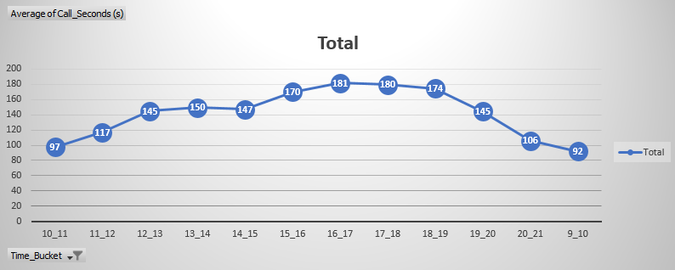
TASKS - 1:
What is the average duration of calls for each time bucket?

Slide 9
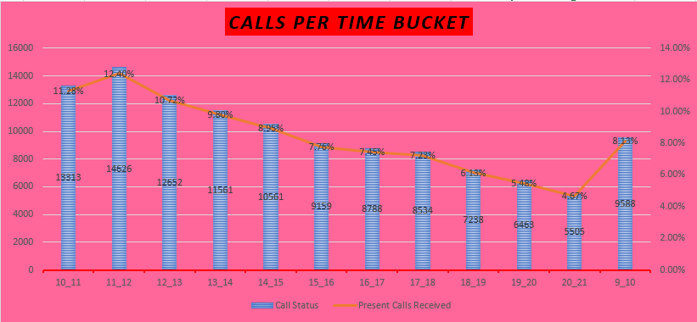
TASK – 2:
Can you create a chart or graph that shows the number of calls received in each time bucket?

Slide 10
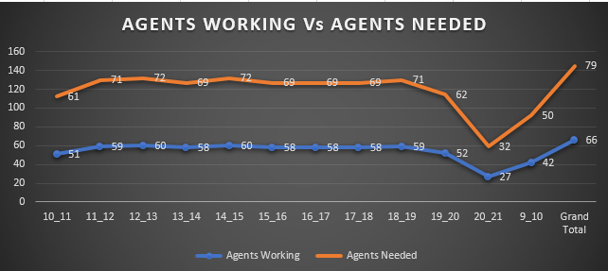
TASK – 3:
What is the minimum number of agents required in each time bucket to reduce the abandon rate to 10%?

Slide 11
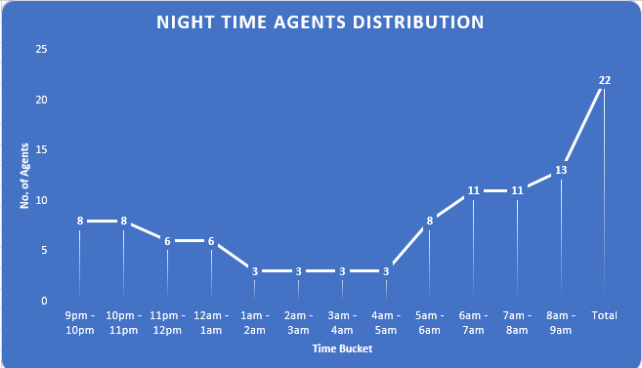
TASK – 4:
Propose a manpower plan for each time bucket throughout the day, keeping the maximum abandon rate at 10%.

Slide 12
CONCLUSION:
In this project, I analyzed the dataset related to incoming calls received by agents and explored various aspects of agent performance and workload. I considered factors such as agent work schedule, unplanned leaves, working hours, occupied time on calls, and other work tasks.
Through our analysis, I found that the average call time duration varied across different time buckets, with some time periods experiencing longer call durations compared to others. Additionally, I observed the distribution of incoming calls across different time buckets, with certain time periods receiving a higher volume of calls.
To improve customer satisfaction and reduce the abandon rate, I proposed a manpower plan that aimed to ensure at least 90 calls are answered out of 100. Based on the current abandon rate and desired abandon rate, I also calculated the minimum number of agents required in each time bucket to achieve this goal.
Considering the agent's working hours, occupied time on calls, and other work tasks, I estimated the number of agents needed in each time bucket. I also factored in additional time for uploading call data and other related tasks. The proposed manpower plan suggested allocating enough agents in each time bucket to handle the workload effectively and reduce the abandon rate.
Furthermore, I highlighted the presence of calls during the night hours and determined the manpower required to handle those calls. I found that 22 unique agents were needed to handle the calls during the night hours.
Overall, this project provided valuable insights into agent performance, call distribution, and manpower planning. By implementing the proposed manpower plan, the organization can improve customer service, reduce the abandon rate, and ensure efficient utilization of agent resources

Slide 13
LINKS:
For Excel:
https://docs.google.com/spreadsheets/d/1SBP7qfmrUcaw2wHd5dtW4Lr2DDjzUwrl/edit?usp=drive_link&ouid=107462117988765805470&rtpof=true&sd=true

Slide 14
THANK YOU

